Slide 1
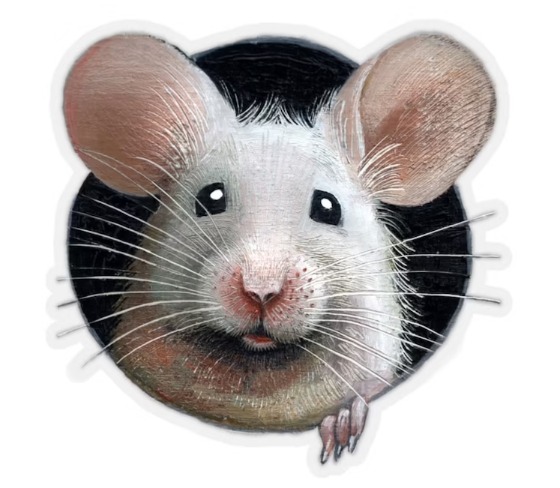
Final Result for Mouse Project of Zero Maze Group
Group Members: Yujia Wang, Yuyang Li, Yuchen Liu

Slide 2
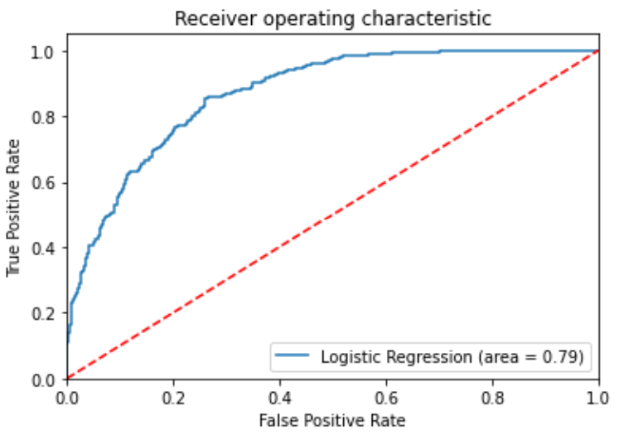
Baseline Model
Logistic regression model
X : Zscores of different cells over time, for example, in one data we had 47 cells in all, so our model having 47 variables.
Y : Mouse showing this behavior or not, classes are 0 and 1
In ROC curve of one random mouse, we can see it’s a good classifier, which stays as far away from the red line.

Slide 3
Exploratory Model
Recurrent neural network (RNN): A type of artificial neural network which uses sequential data or time series data.
X(input) : Took former three/five time points and neurons of the mouse as a matrix.
Y(output) : Behavior of mouse at the fourth/sixth time point.
Training / testing: 80% / 20%, which are split in sequence

Slide 4
Model Introduction
Layer 1: LSTM( A popular RNN architecture, which works to address the problem of long-term dependencies.) with ‘tanh’ activation.
↓
Layer 2 & 3: Dense layer with “relu” activation.
↓
Layer 4: Dense layer with “sigmoid” activation.
More details:
optimizer='adam', loss function='mean_squared_error'
epochs(iteration) = 300, batch_size=32
Notes:
tanh：LSTM – performance will be better
Relu: popular choice
Sigmoid: output is 0 or 1, like logistic

Slide 5
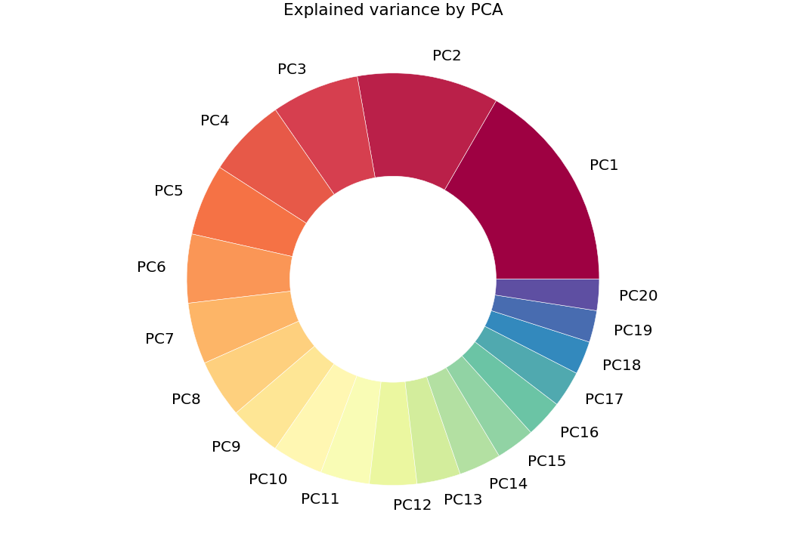
PCA
We tried PCA to reduce dimension of original data before train test splitting.
Here is the variance ratio pie plot after using PCA of Mouse 257. The first components is 16.66%. Then we took top twenty components as input variables.

Slide 6
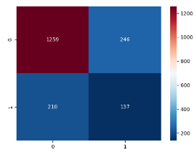
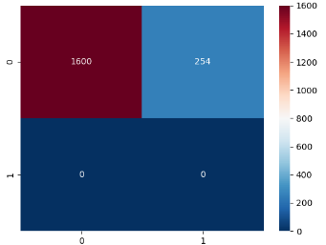
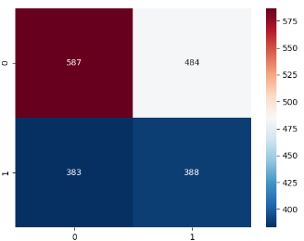
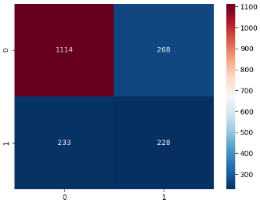
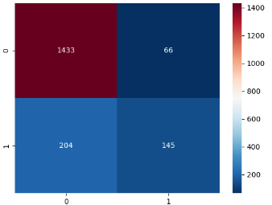
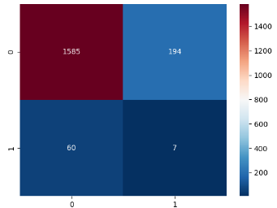
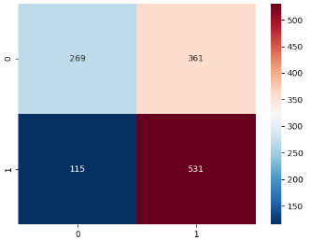
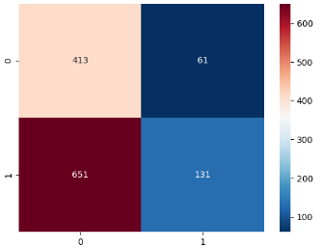
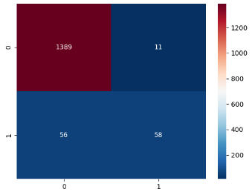
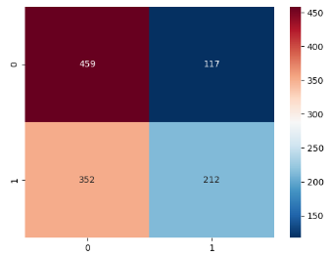
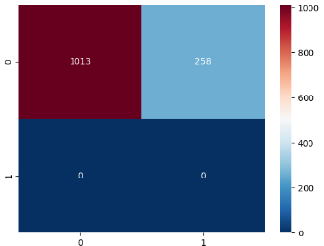
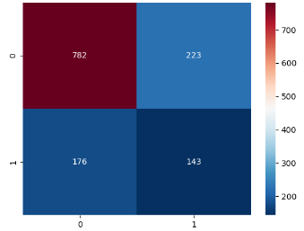
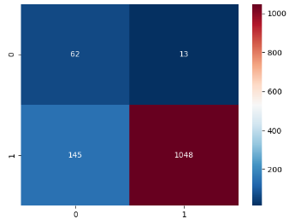
Confusion Matrix
409 412 414
416 417 418 251 256
257 258 274 254 255
Notes:
409","412","414

Slide 7
Mouse 409 Mouse 412
Accuracy: 77% Accuracy: 87%

Slide 8
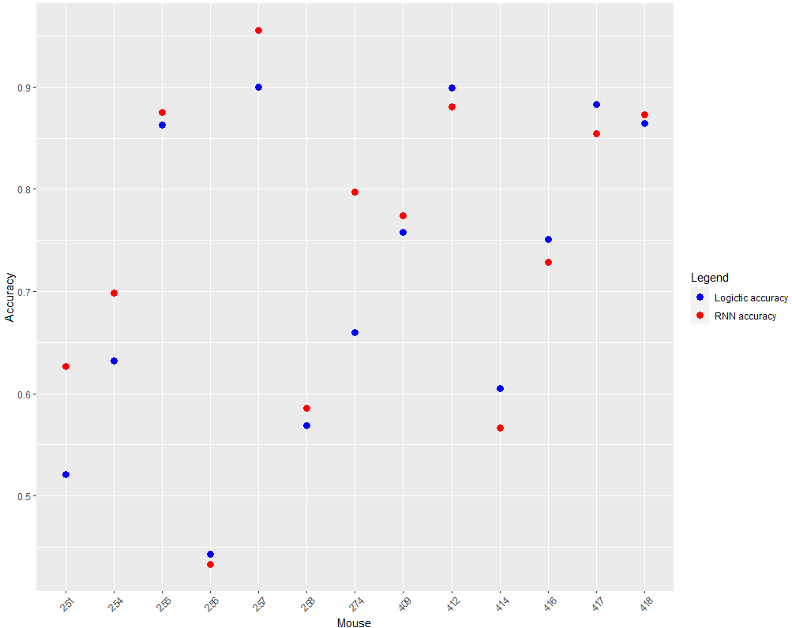
Accuracy of Logistic vs. RNN
After model update of the RNN, we found that the prediction of the behavior of eight mice: 409, 418, 251, 257, 258, 274, 254, 255 was improved.

Slide 9
Take Away Message
The original distribution of behavior 0 and 1 are very imbalance
Correlation exists between cells.
Haven’t found a generalized method that works for all mice.

Slide 10
Thank you!

